Slide 1
How to be a healthy
Present by Zuzia Kuberka 2 c

Slide 2
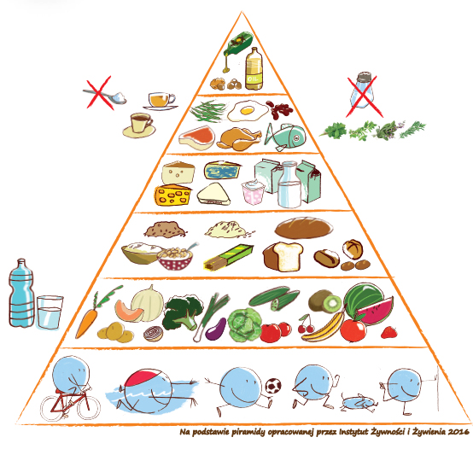
Pyramid of good healthy

Slide 3
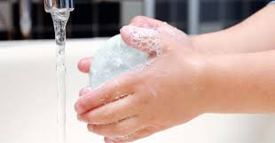
Rember to wash Your hands and clean

Slide 4
EAT WELL

Slide 5
DrINK water

Slide 6
Make same exercise

Slide 7
PLAY

Slide 8
Sleep well

